Slide 1
A unique signum switch for chaos and hyperchaos
Chunbiao Li, Julien Clinton Sprott
Wesley Thio, Huanqiang Zhu
Email: goontry@126.com
chunbiaolee@gmail.com

Slide 2
Acknowledgement --- Cooperators
Julien Clinton Sprott
Wesley Thio
Huanqiang Zhu

Slide 3
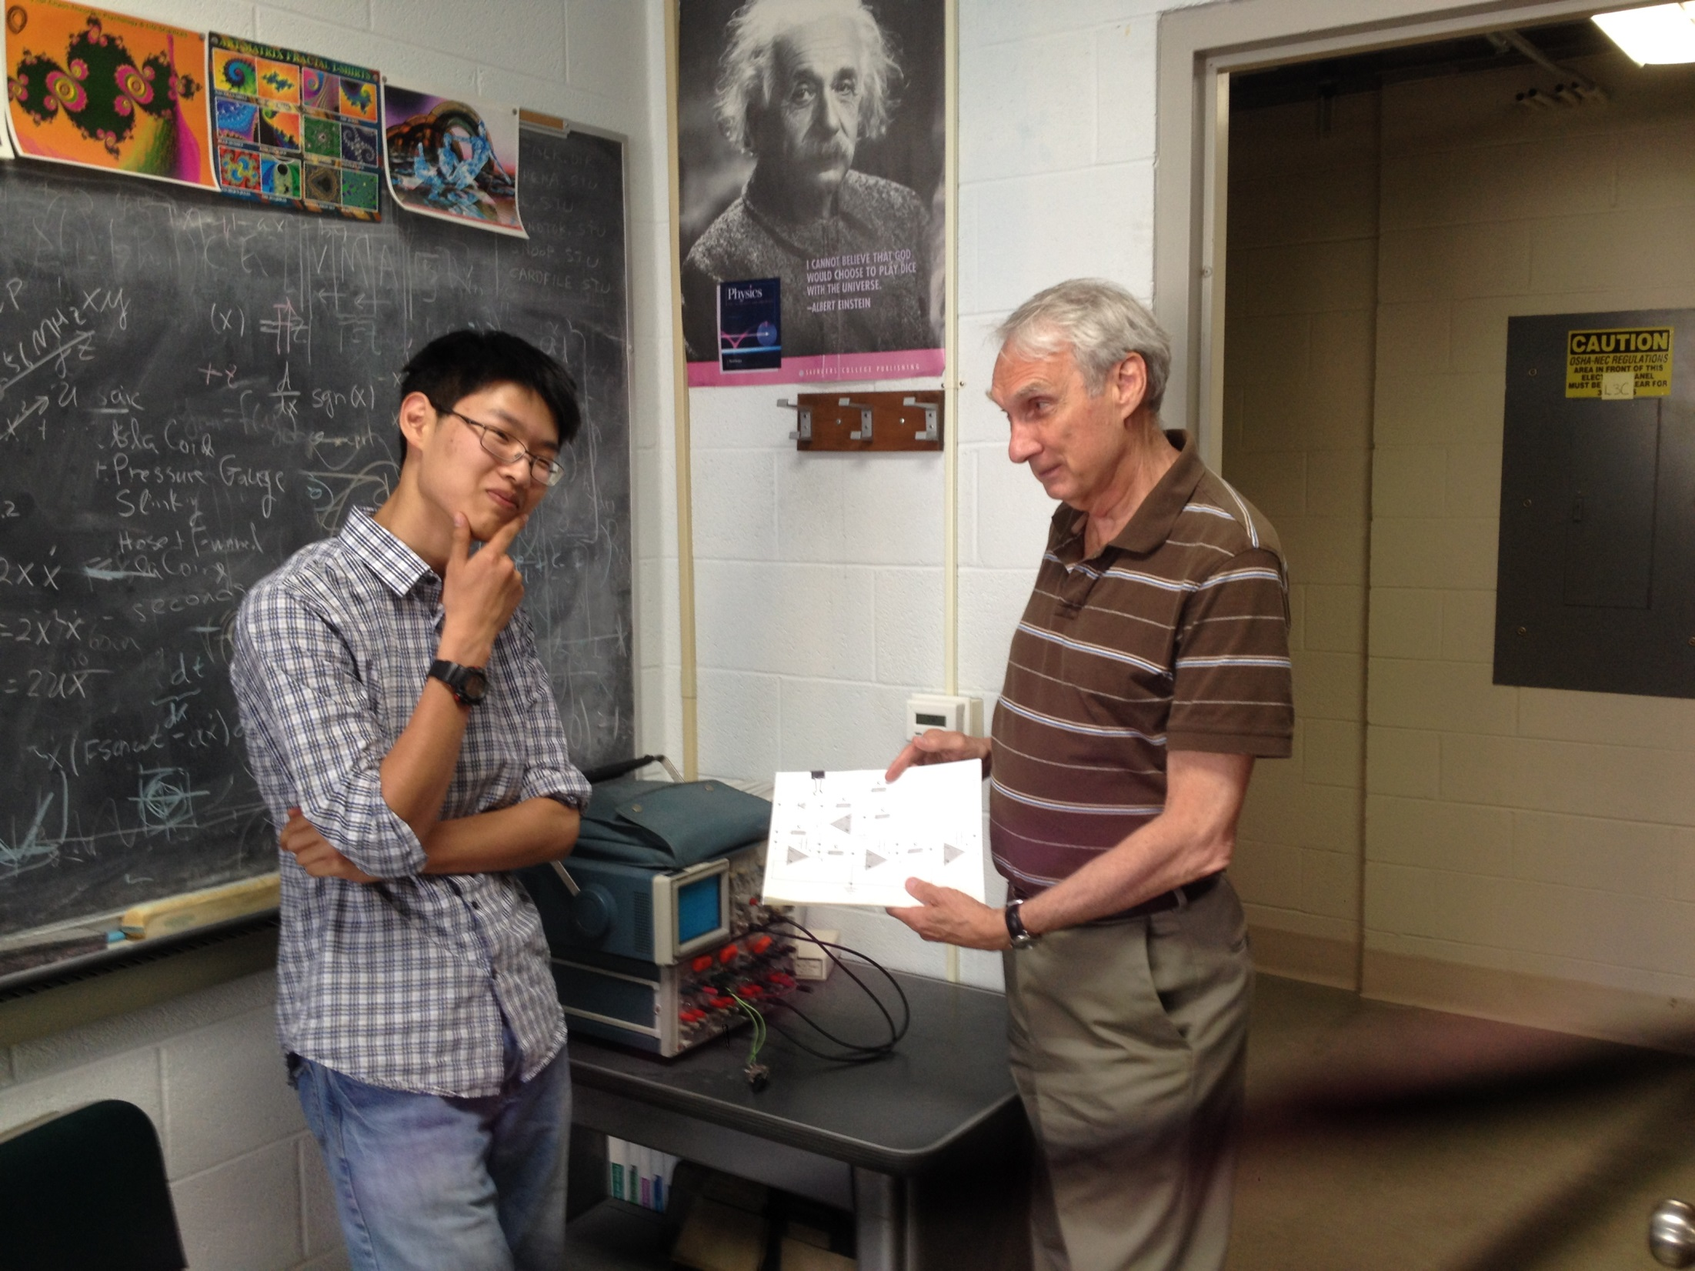

Slide 4
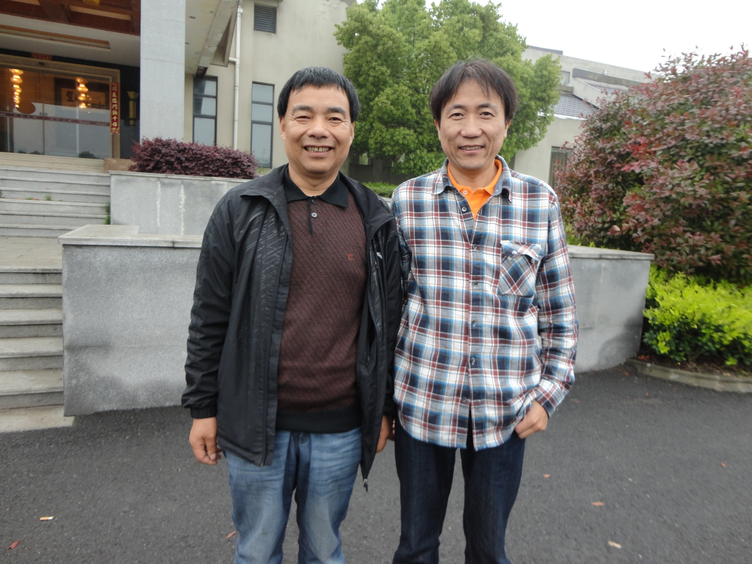

Slide 5
Acknowledgement
This work was supported financially by the Jiangsu Overseas Research and Training Program for University Prominent Young and Middle-aged Teachers and Presidents, the 4th 333 High-level Personnel Training Project (Su Talent [2011] No.15) and the National Science Foundation for Postdoctoral General Program and Special Founding Program of People’s Republic of China (Grant No. 2011M500838 and Grant No. 2012T50456) and Postdoctoral Research Foundation of Jiangsu Province (Grant No. 1002004C).

Slide 6
A Unique Circuit Switch for ASIG(B)
Traditional Method

Slide 7
New Circuit Element

Slide 9
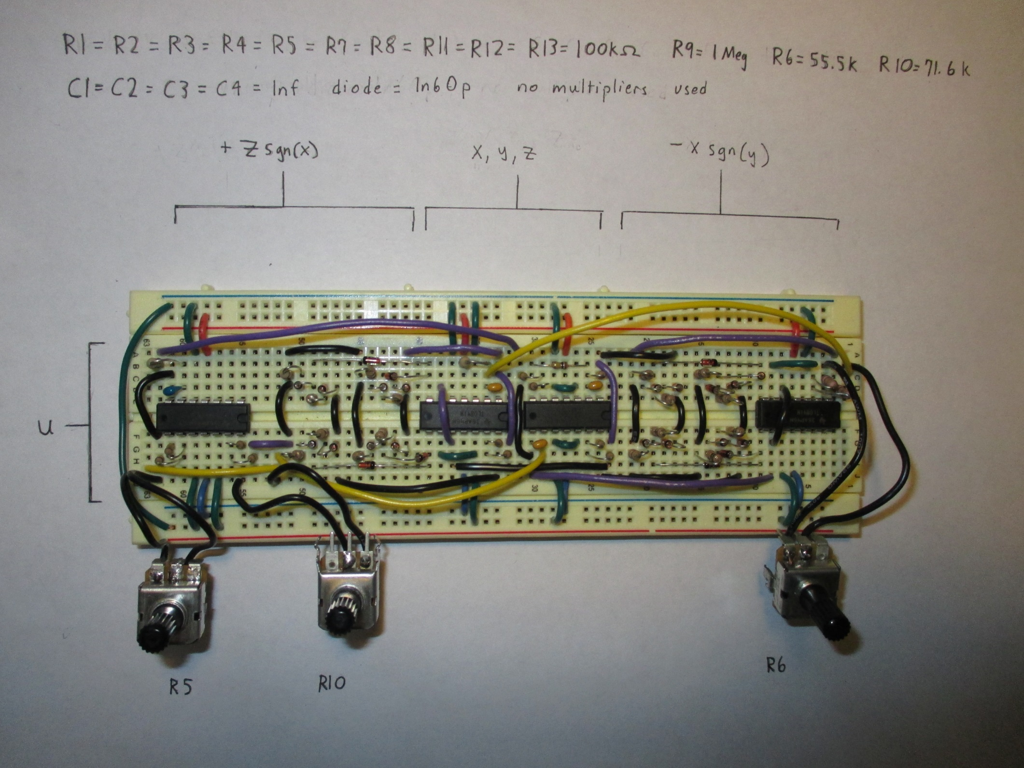

Slide 10
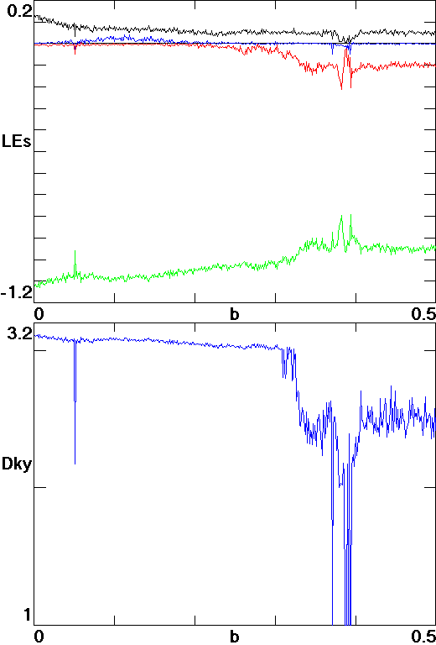
Lyapunov exponents of system versus b at a = 1

Slide 11
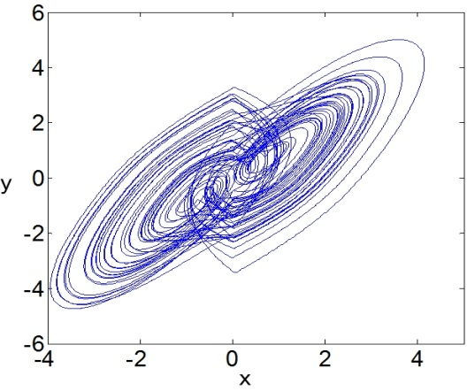
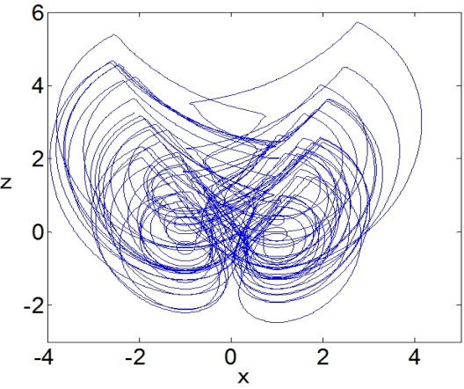
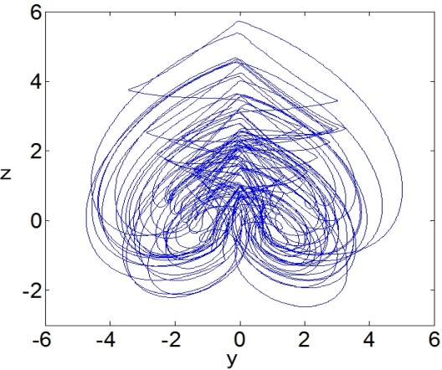
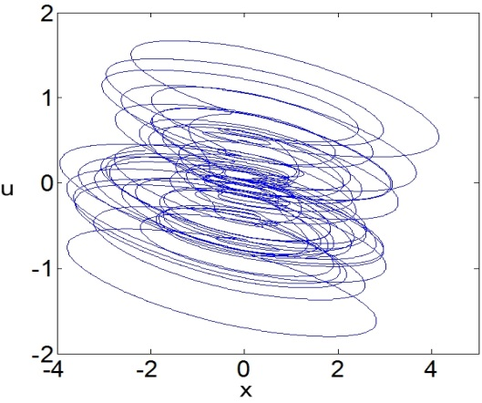
Hyperchaotic attractor with initial conditions (1, 0, 3, 0) (a) x-y phase plane, (b) x-z phase plane, (c) y-z phase plane, (d) x-u phase plane when b = 0.1
(a) (b)
(c) (d)

Slide 12
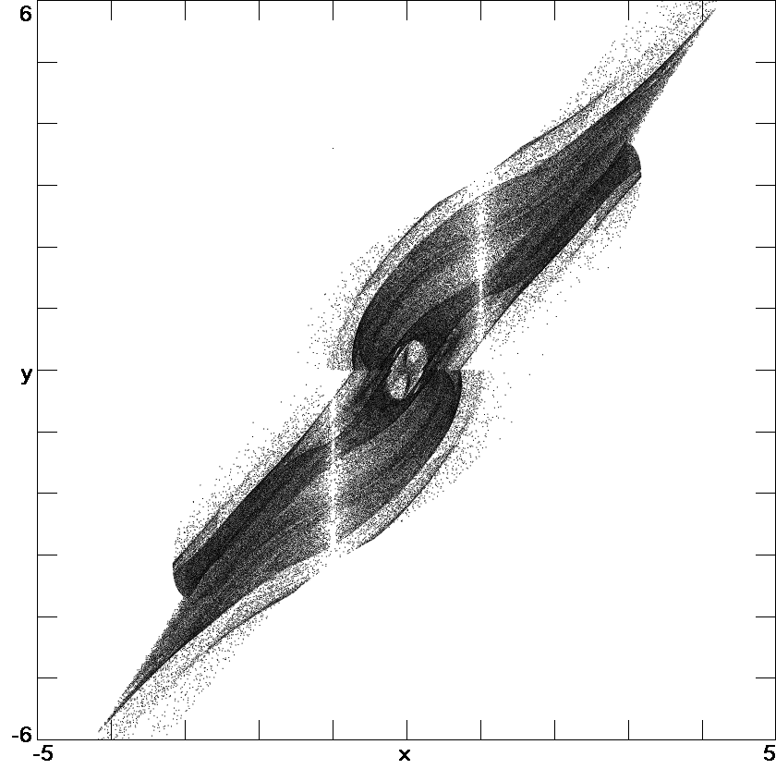
Projection onto the x-y plane of a cross-section of the attractor at z = 0

Slide 13
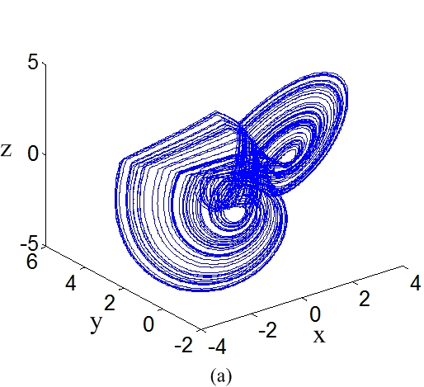
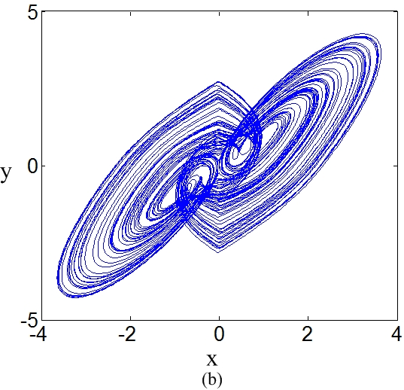
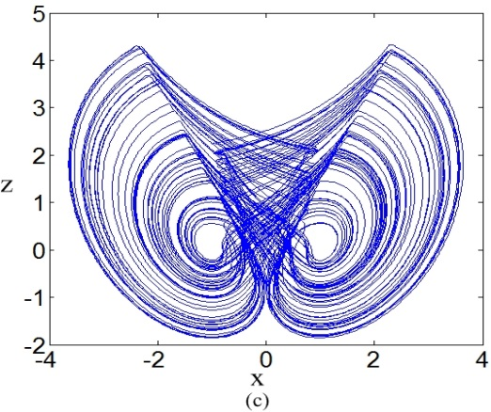
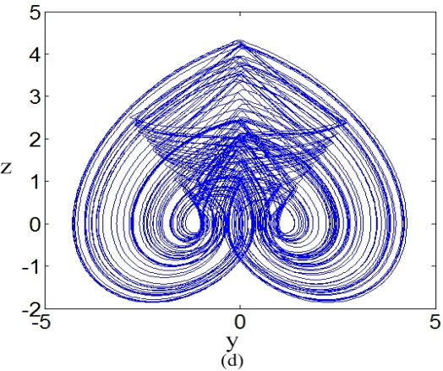
Fig. 1 Chaotic attractor from Eq. (2) for initial conditions (0, 1, 0) with LEs (0.131, 0, -1.131),

Slide 14
Four integration channels in circuit structure for the 4-D system

Slide 15
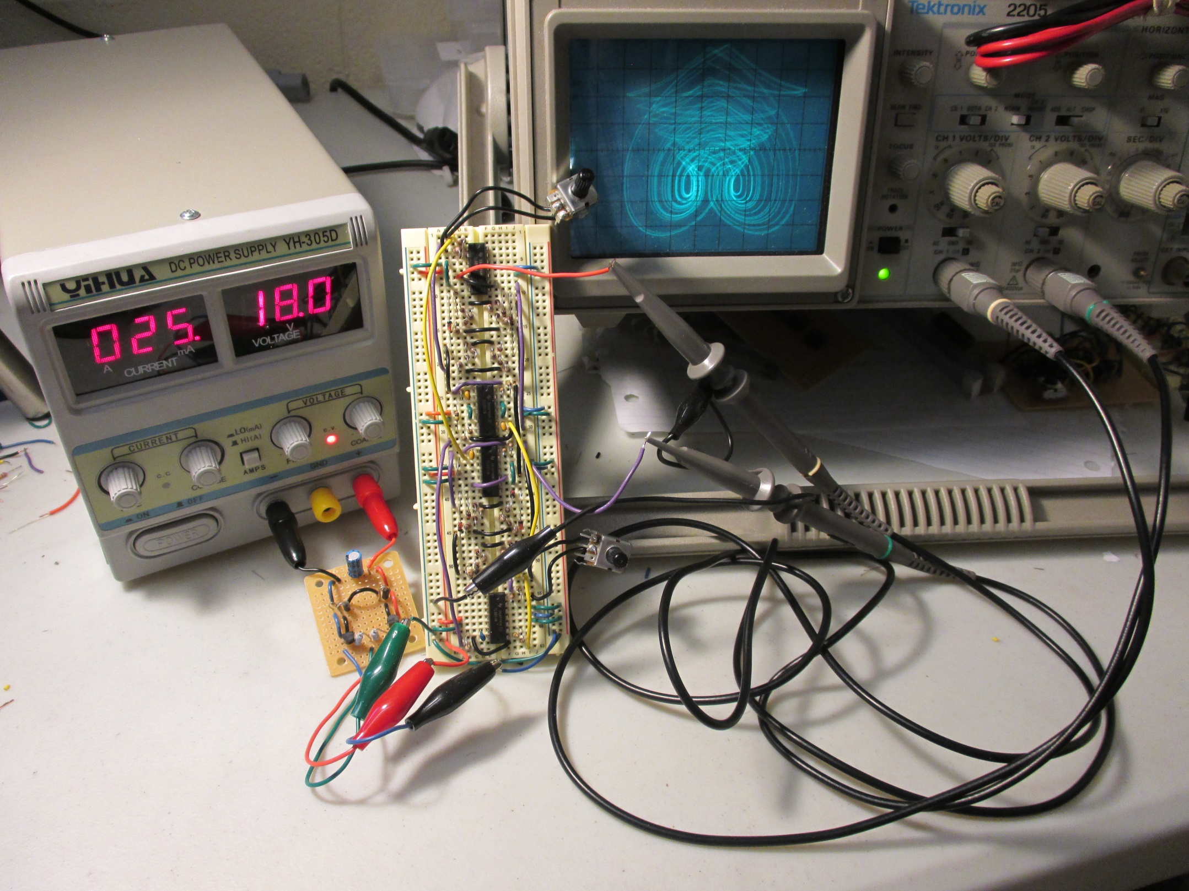

Slide 16
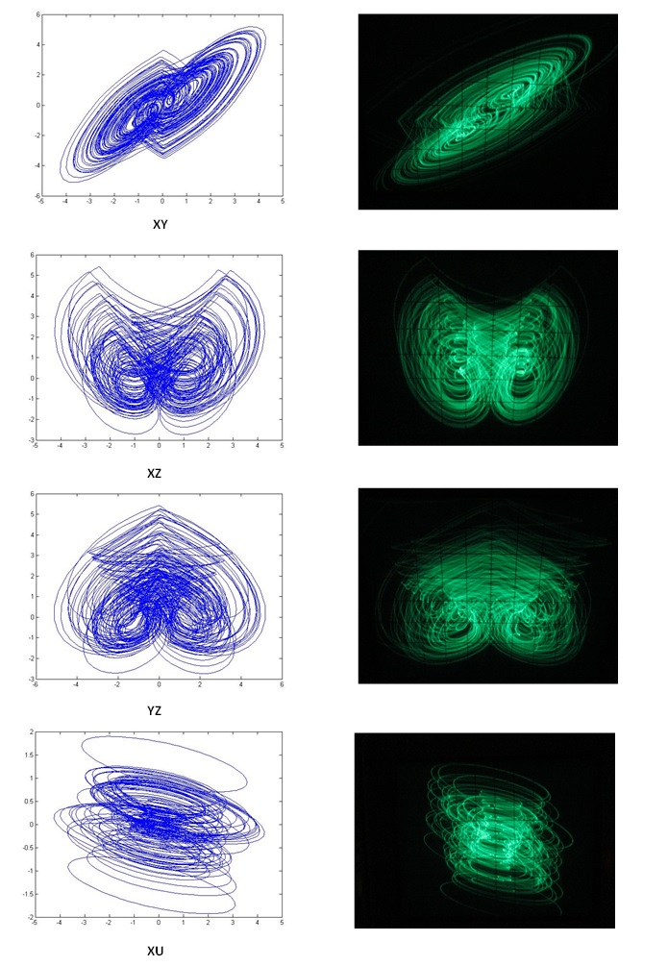
Oscilloscope traces of hyperchaotic attractors (a) x-y plane, (b) x-z plane, (c) y-z plane, (d) x-u plane (1V/div).
(c) (d)

Slide 17
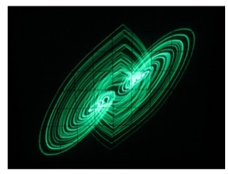
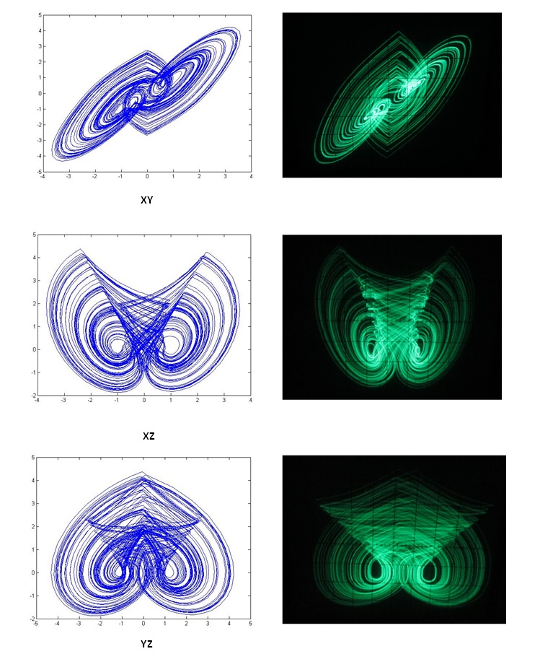
Experimental phase portraits of 3-D chaotic system (a) x-y plane, (b) x-z plane, (c) y-z plane (1V/div).

Slide 19
Thanks

