Slide 1

Ergodicity in Chaotic Oscillators
Clint Sprott
Department of Physics
University of Wisconsin – Madison USA
Presented at the
Chaos and Complex Systems Seminar
Madison, Wisconsin
on
November 20, 2018

Slide 2
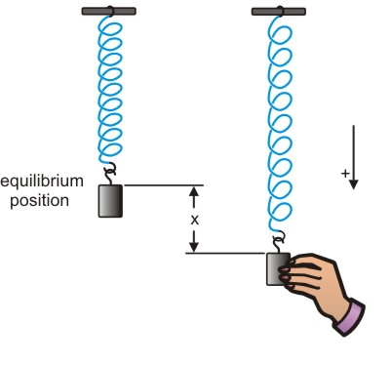
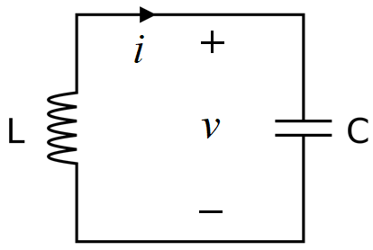
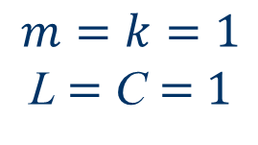
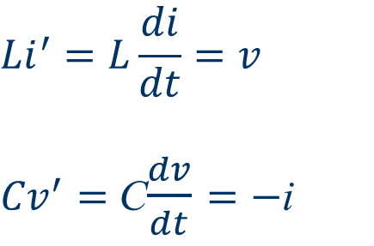
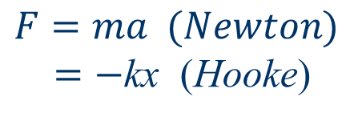
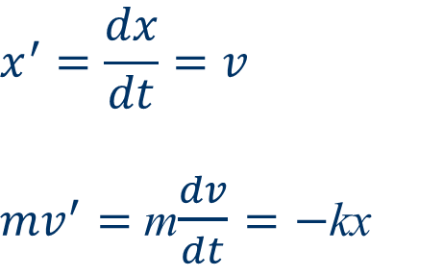
Simple Harmonic Oscillator
$$F=ma (Newton)$$
$=−$kx (Hooke)
$$x^{′}=\frac{dx}{dt}=v$$
${mv}^{′}=$ m$\frac{dv}{dt}=−$kx
$${Li}^{′}=L\frac{di}{dt}=v$$
${Cv}^{′}=$ C$\frac{dv}{dt}=−$i
$$m=k=1$$
L $=$ C $=$ $1$

Slide 3
Other Harmonic Oscillators
Pendulums
Musical Instruments
Clocks
Diatomic Molecules
Population Dynamics
Financial Market Cycles
Heartbeats …

Slide 4
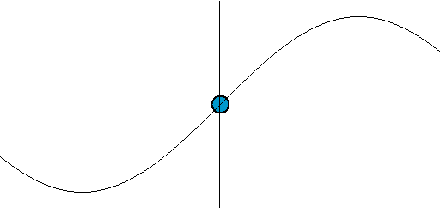
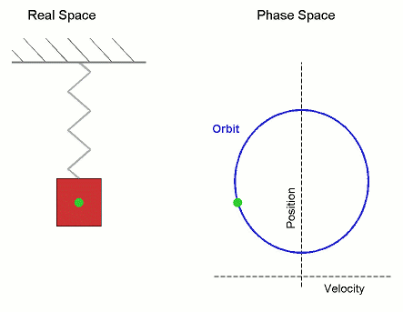
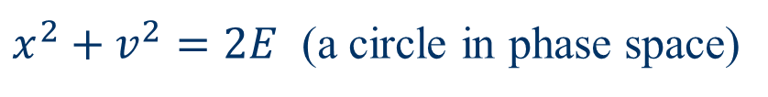
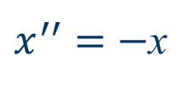


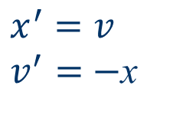
Simple Harmonic Oscillator
$$x^{′}=v$$
$v^{′}=$ $−$x
$$x=\sin{t}$$
$$v=\cos{t}$$
$x^{′′}=$ $−$x
${\text{Energy}\text{:} E=\frac{1}{2}x}^{2}+{\frac{1}{2}v}^{2}$ $=$ constant
Conservative
(Hamiltonian)
System
$x^{2}+v^{2}=2E$ (a circle in phase space)

Slide 5
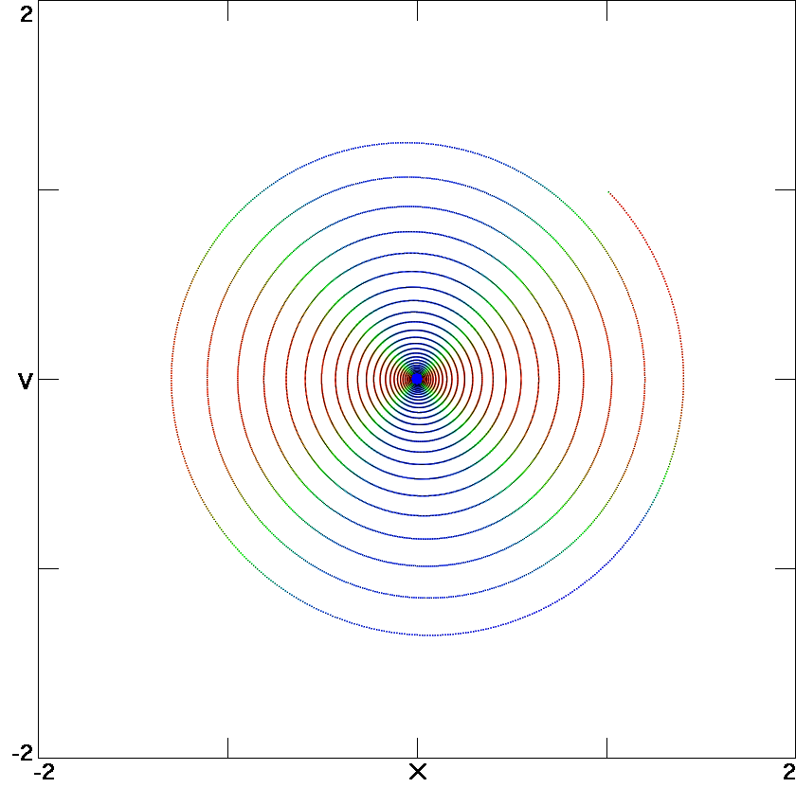
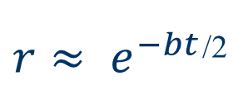
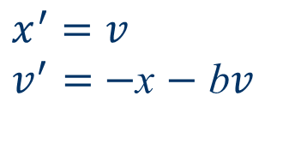
Damped Harmonic Oscillator
$$x^{′}=v$$
$v^{′}=$ $−$x $−$ b$v$
b = 0.05
bv ⇒ Linear damping
(friction or air resistance)
b is damping constant
Q = 1/b (quality factor)
Equilibrium (focus)
Point attractor
Globally attracting
Time-irreversible
Dissipative system
$r≈ e^{−bt}$^{/2}
Not true!

Slide 6
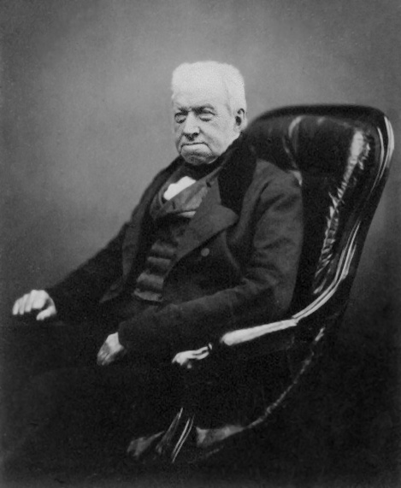
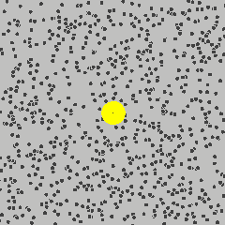
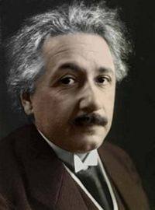
Browninan Motion
Robert Brown
Scottish botanist
(1773 – 1858)
Albert Einstein
1905
Atoms exist!

Slide 7
Ideal Gas
Every breath you take is about half a liter of air and contains about 10²² molecules
each with a mass of about 10⁻²⁵ kilograms
moving at an average speed of about 1000 meters/second (500 miles/hour)
traveling about 10⁻⁵ cm between collisions
and includes a molecule that was in the last dying breath of Julius Caesar (or Jesus or …).

Slide 8
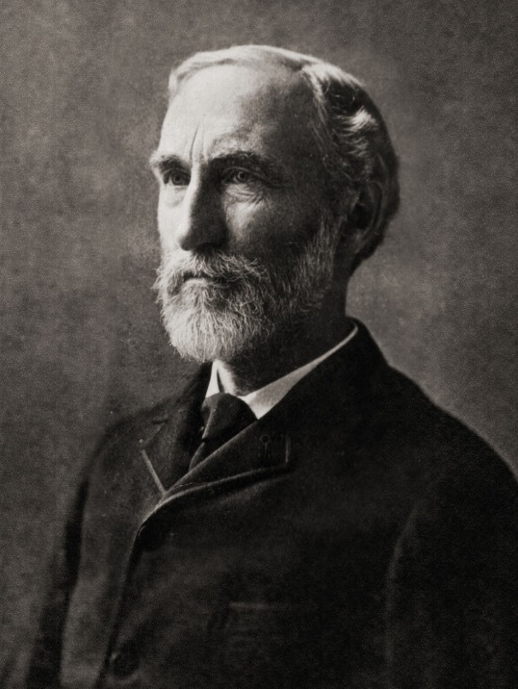
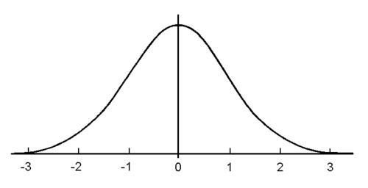

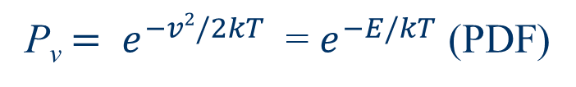
Gibbs’ Canonical Distribution
First American PhD in engineering (1863)
Professor of Mathematical Physics at Yale
Founder of statistical mechanics
Wrote famous 1902 textbook
Gaussian (normal) distribution
P_{v}$= e^{−v2/2kT}$ = $e^{−E/kT}$ (PDF)
P_{v}
“bell curve”
Josiah Willard Gibbs
American Scientist
(1839 – 1903)
$$v$$

Slide 9
Ergodicity
Time average = ensemble average
Initial conditions do not matter
Every point is phase space is visited
Is the harmonic oscillator ergodic?
Is a social society ergodic?

Slide 10
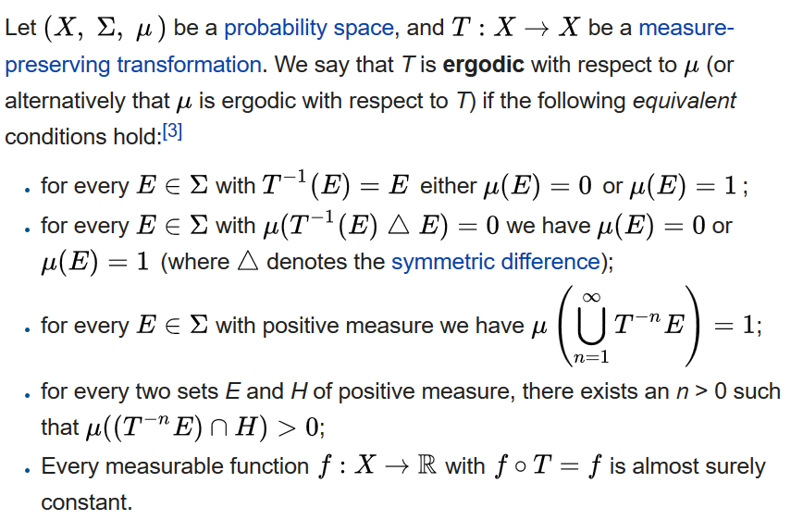
Ergodicity (formal definition)

Slide 11
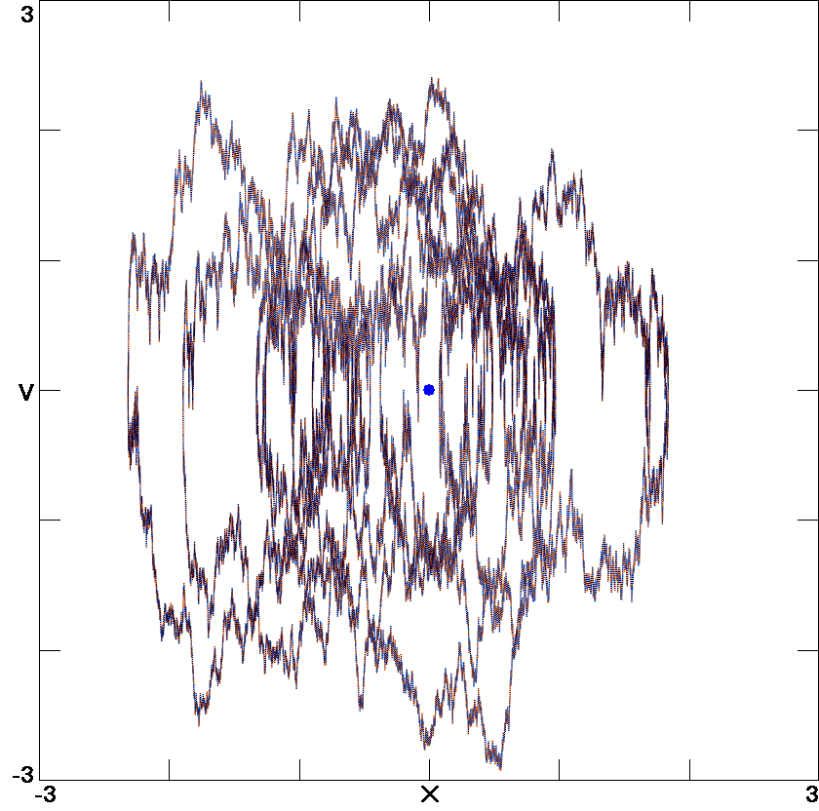
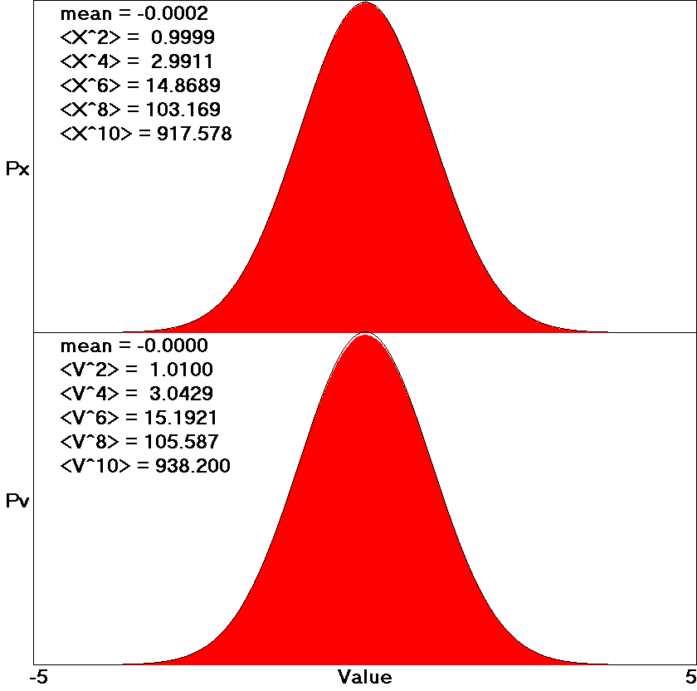
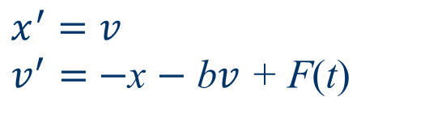
Stochastic Harmonic Oscillator
$$x^{′}=v$$
$v^{′}=$ $−$x $−$ b$v$ + F(t)
b = 1
F(t) is random forcing
Ergodic but not chaotic
(rather it is “stochastic”)

Slide 12
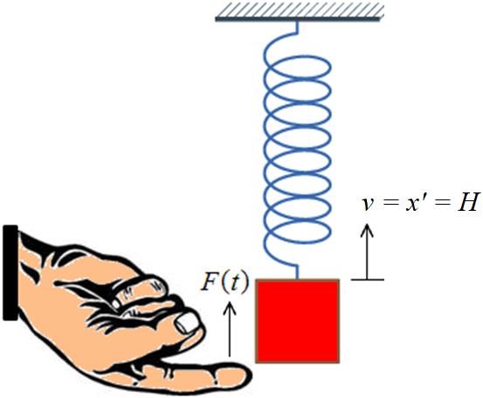
“The Finger of Fate”

Slide 13
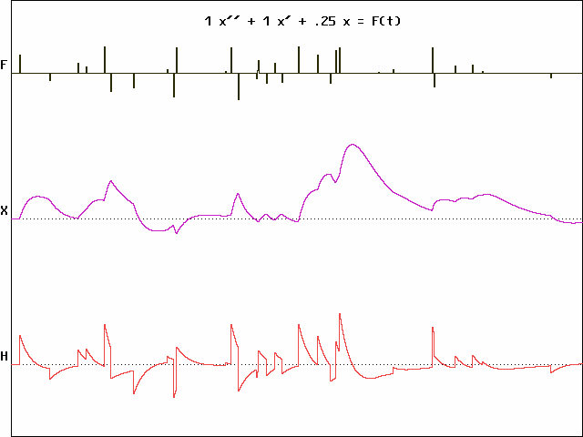
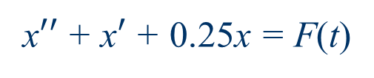
Happiness Model
x$′′$+ x$′$+ 0.25x = F(t)
Time →

Slide 14
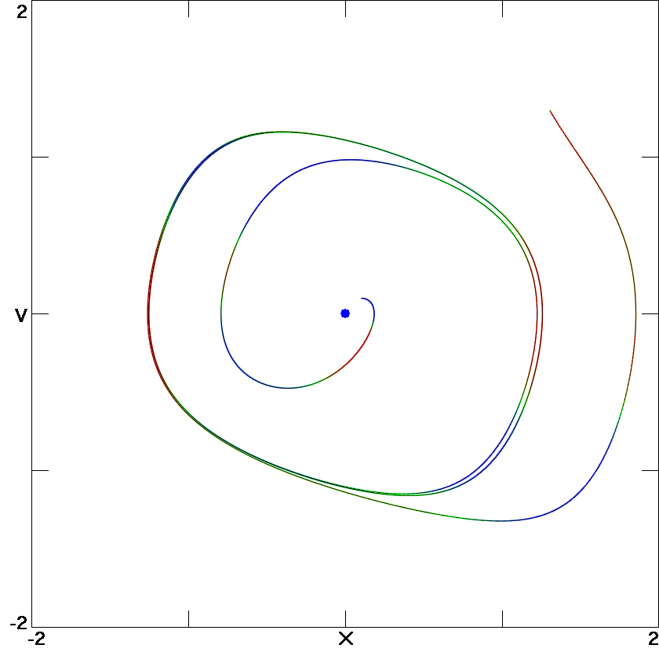
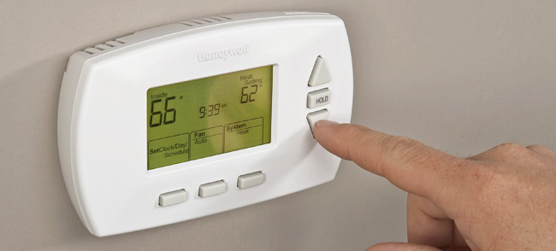
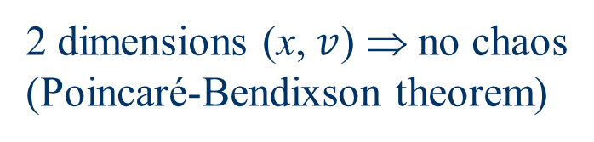
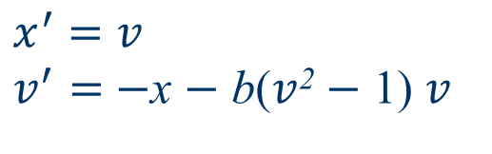
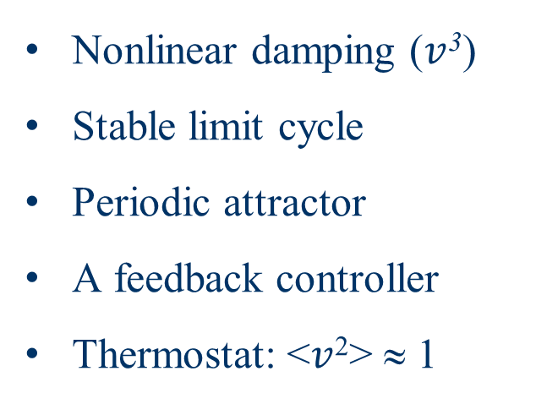
Rayleigh Oscillator
$$x^{′}=v$$
$v^{′}=$ $−$x $−$ b($v$² $−$ 1) $v$
b = 1
Bipolar disorder?
Nonlinear damping ($v$³)
Stable limit cycle
Periodic attractor
A feedback controller
Thermostat: <$v$²> ≈ 1
2 dimensions (x, $v$) ⇒ no chaos
(Poincaré-Bendixson theorem)

Slide 15
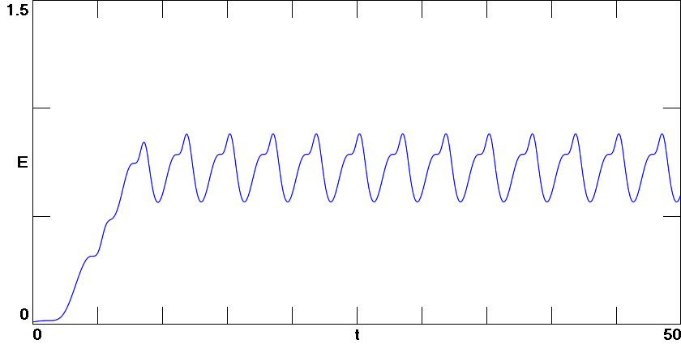
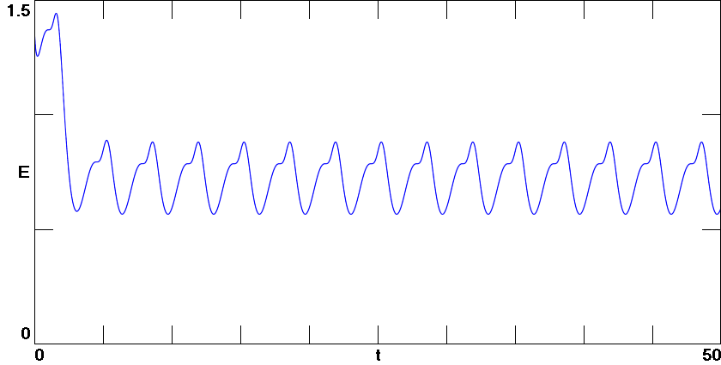
Energy vs Time
cold start
hot start

Slide 16
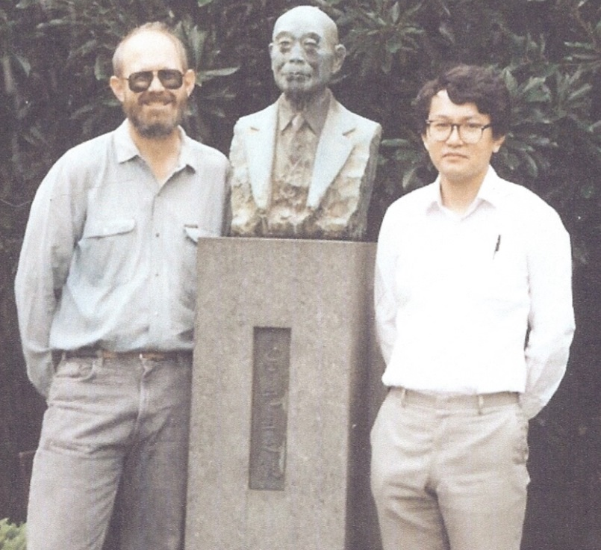
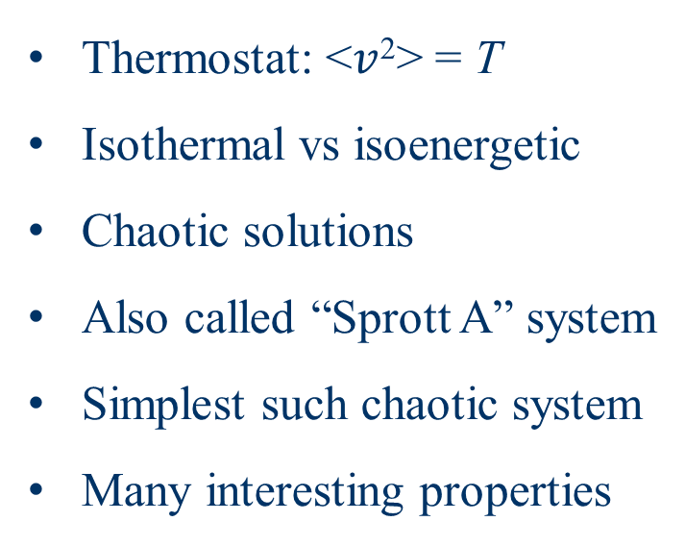
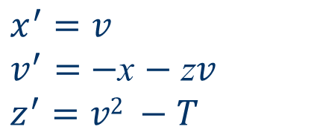
Nosé-Hoover Oscillator
$$x^{′}=v$$
$v^{′}=$ $−$x $−$ z$v$
$$z^{′}=v2 −T$$
Thermostat: <$v$²> = T
Isothermal vs isoenergetic
Chaotic solutions
Also called “Sprott A” system
Simplest such chaotic system
Many interesting properties
Bill Hoover & Shuichi Nosé (1989)

Slide 17
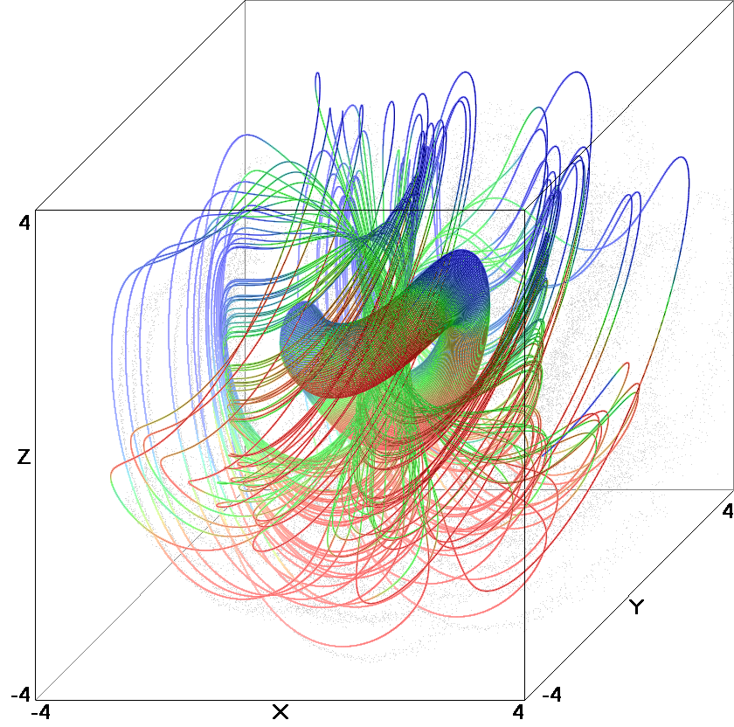
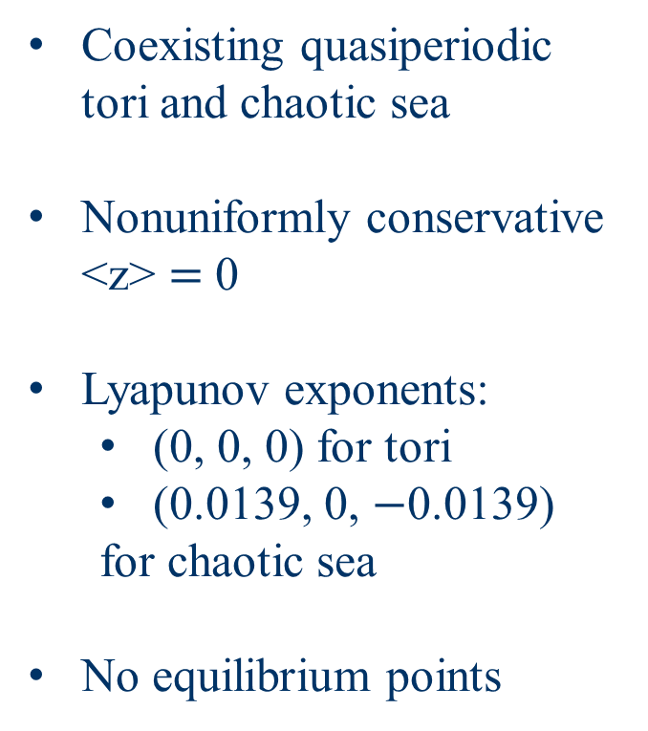

Nosé-Hoover Oscillator (cont)
$$x^{′}=v$$
$v^{′}=$ $−$x $−$ z$v$
$$z^{′}=v2 −T$$
T = 1
Coexisting quasiperiodic tori and chaotic sea
Nonuniformly conservative <z> $=$ 0
Lyapunov exponents:
  (0, 0, 0) for tori
  (0.0139, 0, $−$0.0139)
  for chaotic sea
No equilibrium points

Slide 18
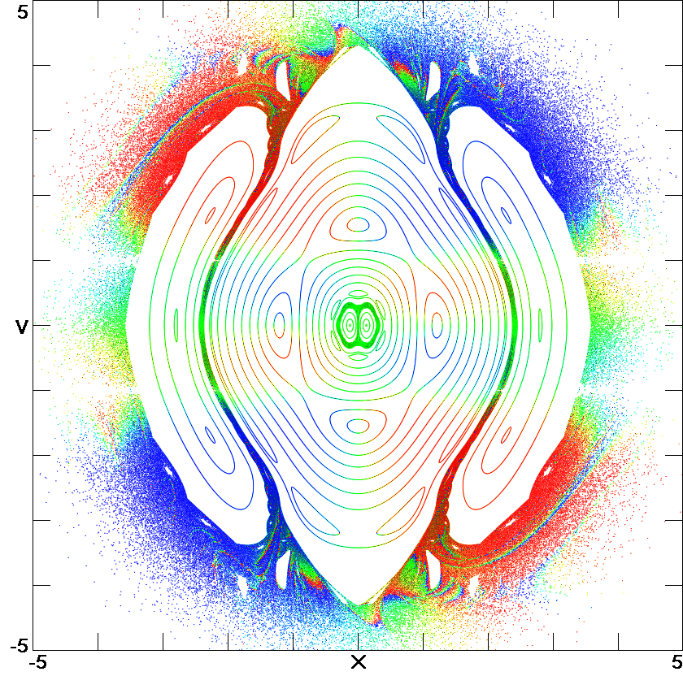
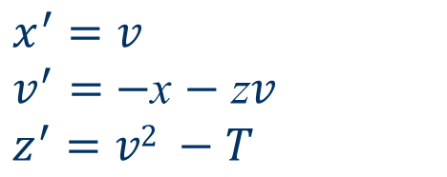
Nosé-Hoover Oscillator (cont)
$$x^{′}=v$$
$v^{′}=$ $−$x $−$ z$v$
$$z^{′}=v2 −T$$
T = 1
z = 0
Fat fractal (many “holes”)
Non-Gaussian
Time-reversible
Only 6% chaotic
Not ergodic

Slide 19
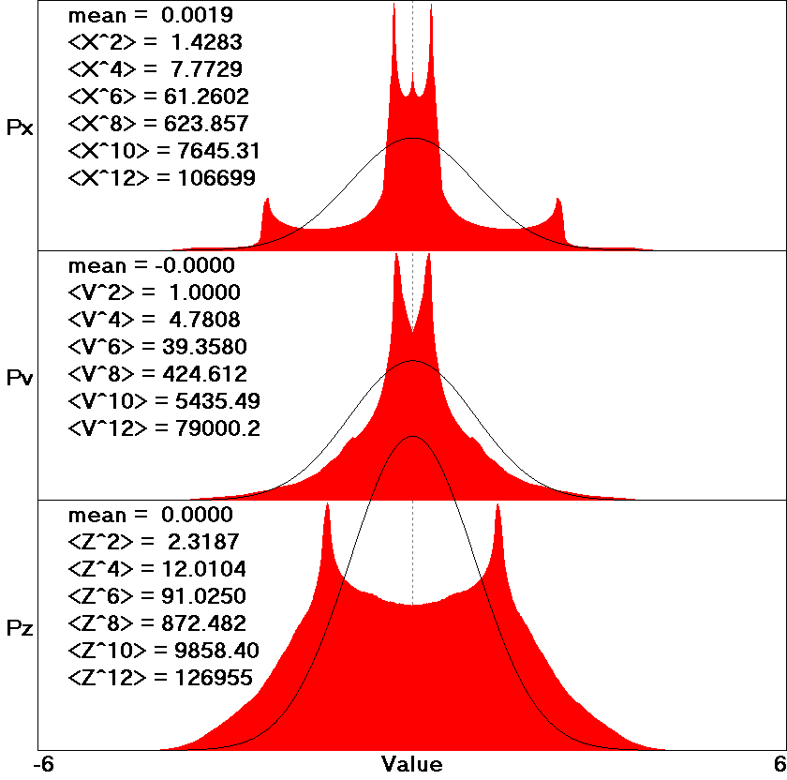
Nosé-Hoover Oscillator (cont)
Bipolar disorder?

Slide 20
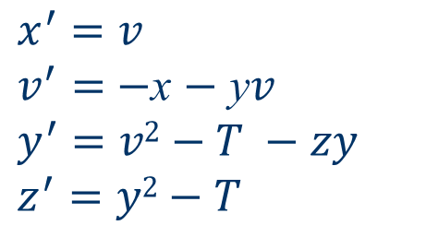
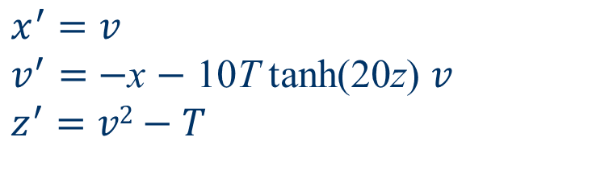
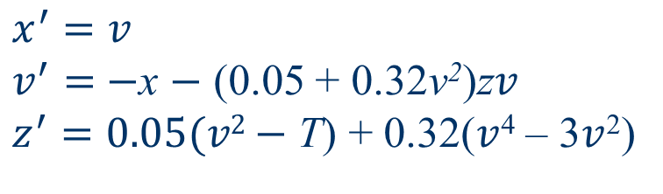
Ergodic Thermostats
$$x^{′}=v$$
$v^{′}=$ $−$x $−$ y$v$
$$y^{′}=v2−T −zy$$
$$z^{′}=y2−T$$
$$x^{′}=v$$
$v^{′}=$ $−$x $−$ (0.05 + 0.32v²)z$v$
$z^{′}=0.05(v2−$ T) + 0.32($v$⁴ – 3$v$²)
$$x^{′}=v$$
$v^{′}=$ $−$x $−$ 10T tanh(20z) $v$
$$z^{′}=v2−T$$

Slide 21
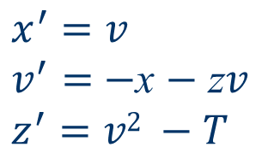
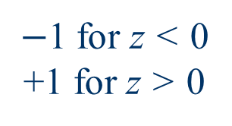
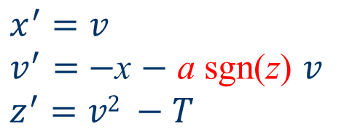
Signum Thermostat
$$x^{′}=v$$
$v^{′}=$ $−$x $−$ z$v$
$$z^{′}=v2 −T$$
Proportional
controller
Nose-Hoover:
$$x^{′}=v$$
$v^{′}=$ $−$x $−$ a sgn(z) 𝑣
$$z^{′}=v2 −T$$
Signum thermostat:
Bang-bang
controller
{
$−$1 for z < 0
+1 for z > 0
Signum function:
sgn(z) =

Slide 22
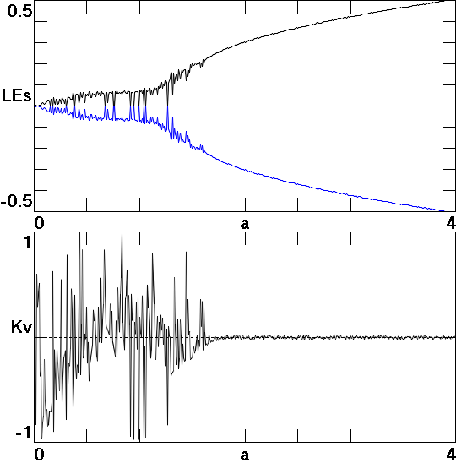
A Single Parameter
Golden mean = 1.61803…

Slide 23

Yes, it is Chaotic
a = 2
T = 1

Slide 24

Yes, it is Isothermal
a = 2
T = 1

Slide 25

Yes, it is Ergodic
a = 2
T = 1
z = 0

Slide 26

Yes, it is Gaussian
a = 2
T = 1

Slide 27

The Signum Thermostat
Is mathematically elegant.
Has only a single parameter.
Works for a wide variety of oscillators.
Invites analytic analysis and proofs.
$${ x}^{′}=v$$
${ v}^{′}=$ $−$x $−$ 2$v$ sgn z
$${ \text{z}}^{′}=v2 −1$$

Slide 28
Summary
The harmonic oscillator is the oldest and most important dynamical system.
With a signum thermostat, it can be made to replicate a truly random system.
The system is ripe for further analysis and study.

Slide 29
References
http://sprott.physics.wisc.edu/ lectures/ergodicity.pptx (this talk)
http://sprott.physics.wisc.edu/pubs/paper499.pdf (written version)
http://sprott.physics.wisc.edu/chaostsa/ (my chaos textbook)
sprott@physics.wisc.edu (contact me)

